Slide 1
Basics of Arrangement Architecture
March 2014

Slide 2
Objective
At the end of the session the participants will be conversant in
Understanding Arrangement Architecture
Learning Various Product Components
Designing a Product
Relationship between Product and Arrangement

Slide 3
INTRODUCTION – Arrangement Architecture
Notes:
Till Arrangement architecture came into T24, each T24 module - AC, MG, LD, MM, AZ etc. had a purpose built silo. Functionality and product features exist within these silos. Each module has different product definitions and parameters.
Under Account module , we have different types of accounts, such as Current Accounts, Savings Accounts, Overdraft Accounts and various parameter tables. Similarly under LD module, we have deposits and lending functionality, with its own parameter tables. Each of the T24 Product modules have their own parameter tables, transaction tables and processing logic.
Even to service a single product, multiple modules have to be implemented. Local Developments for simple things like Availability of a product was inevitable. Customisation involved additional local developments as per the client’s requirements.

Slide 4
An Alternative Approach
Current Accounts
Saving Accounts
Term Deposits
Lending
Cards
Etc….
Account
Account
Account
Account
Account
Account
Attributes
Actions
Attributes
Actions
Attributes
Actions
Attributes
Actions
Attributes
Actions
Attributes
Actions
Accounting
Accounting
Accounting
Accounting
Accounting
Accounting
Attributes
Actions
Attributes
Actions
Attributes
Actions
Attributes
Actions
Attributes
Actions
Attributes
Actions
Charge
Charge
Charge
Charge
Charge
Charge
Attributes
Actions
Attributes
Actions
Attributes
Actions
Attributes
Actions
Attributes
Actions
Attributes
Actions
Interest
Interest
Interest
Interest
Interest
Interest
Attributes
Actions
Attributes
Actions
Attributes
Actions
Attributes
Actions
Attributes
Actions
Attributes
Actions
Payment Schedule
Payment Schedule
Payment Schedule
Payment Schedule
Payment Schedule
Payment Schedule
Attributes
Actions
Attributes
Actions
Attributes
Actions
Attributes
Actions
Attributes
Actions
Attributes
Actions
Term Amount
Term Amount
Attributes
Actions
Attributes
Actions
Limit
Limit
Attributes
Actions
Attributes
Actions
Settlement
Settlement
Settlement
Settlement
Settlement
Settlement
Attributes
Actions
Attributes
Actions
Attributes
Actions
Attributes
Actions
Attributes
Actions
Attributes
Actions
Notes:
The AA module provides a flexible framework that allows a number of new T24 modules to be created. The application provides a business component based architecture for the management of products. Using AA, we will be moving to a modular Product architecture, whereby Users can create their own Products by using the Components provided by Temenos, and these components can be reused across many Products.

Slide 5
Components act Transversally
A Component – build once, reuse in any product
Current Accounts
Saving Accounts
Term Deposits
Lending
Cards
Etc….
Account (BALANCE)
Account
Account
Account
Account
Account
Account
Attributes
Actions
Attributes
Actions
Attributes
Attributes
Actions
Actions
Attributes
Actions
Attributes
Actions
Attributes
Actions
Accounting (POSITION KEEPING)
Accounting
Accounting
Accounting
Accounting
Accounting
Accounting
Attributes
Actions
Attributes
Actions
Attributes
Attributes
Actions
Actions
Attributes
Actions
Attributes
Actions
Attributes
Actions
Charge
Charge
Charge
Charge
Charge
Charge
Charge
Attributes
Actions
Attributes
Actions
Attributes
Attributes
Actions
Actions
Attributes
Actions
Attributes
Actions
Attributes
Actions
Interest
Interest
Interest
Interest
Interest
Interest
Interest
Attributes
Actions
Attributes
Actions
Attributes
Attributes
Actions
Actions
Attributes
Actions
Attributes
Actions
Attributes
Actions
Repayment Schedule
Payment Schedule
Payment Schedule
Payment Schedule
Payment Schedule
Payment Schedule
Payment Schedule
Attributes
Actions
Attributes
Actions
Attributes
Attributes
Actions
Actions
Attributes
Actions
Attributes
Actions
Attributes
Actions
Term Amount
Term Amount
Attributes
Actions
Attributes
Actions
Limit
Limit
Attributes
Actions
Attributes
Actions
Settlement
Settlement
Settlement
Settlement
Settlement
Settlement
Attributes
Actions
Attributes
Actions
Attributes
Actions
Attributes
Actions
Attributes
Actions
Attributes
Actions
Notes:
In AA there is a three tiered Product Organisation comprising of Product Lines defined by Temenos. Product Groups and Products are defined by Users. Lending, Internet Services, Accounts, Deposits, Product Bundle are some of the Product Lines in AA.
Every product is an assembly of many components. For example, for the LENDING products, we have components like Term Amount, Payment Rules, Limit, Periodic Rules, Accounting, Interest, etc. For Account products, we have components like Account, Eligibility, Accounting, Charge, Interest etc. These components are serviced in AA.

Slide 6
Product Building – Components to Product Lines
Product Lines are constructed by combining components
Product Design & Definition
Product Lines
Lending
Term Deposits
Accounts
Product Bundles
Product Components
Customer
Officer
Limit
Account
Accounting
Attributes
Actions
Attributes
Actions
Attributes
Actions
Attributes
Actions
Attributes
Actions
Activity Restriction
Activity Mapping
Activity Presentation
Activity Messaging
Activity API
Attributes
Actions
Attributes
Actions
Attributes
Actions
Attributes
Actions
Attributes
Actions
Term Amount
Payment Schedule
Payment Rules
Overdue
Payoff
Attributes
Actions
Attributes
Actions
Attributes
Actions
Attributes
Actions
Attributes
Actions
Interest
Charge
Activity Charge
Payout Rules
Tax
Attributes
Actions
Attributes
Actions
Attributes
Actions
Attributes
Actions
Attributes
Actions
Change Product
Closure
Alerts
Settlement
Periodic Charges
Attributes
Actions
Attributes
Actions
Attributes
Actions
Attributes
Actions
Attributes
Actions
Availability
Interest Compensation
Bundle
Eligibility
Attributes
Actions
Attributes
Actions
Attributes
Actions
Attributes
Actions
Notes:
Product Lines are released by Temenos. Each product line is constructed by combining the various, available, reusable components. Product lines e.g. Lending, Deposits, Accounts, Product bundle.

Slide 7
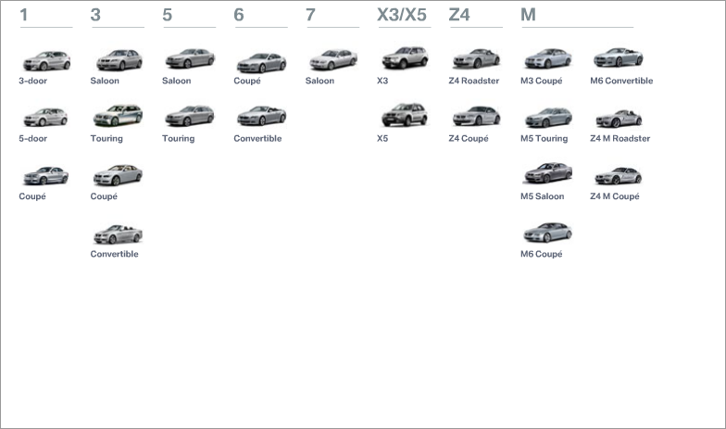
Organisation of BMW’s Product Catalogue
Product Line (Cars)
Product Groups
Product Derivatives
Notes:
BMW produces cars and they do not stop with one product, they also produce motor bikes. These two items, whilst sharing a common purpose to transport people, are clearly different Product Lines. We call these broad categories as Product Lines.
Within their car product line, BMW has built a number of models which are clearly segregated into groups such as the 3 series, 5 series, 7 series, etc. We will refer them as Products Groups. These product Groups go on to form the highest level in a complex product line hierarchy.
Within each product group, there are further subdivisions based on various factors. For instance, the first subdivision is based on the body style of the car such as a saloon, coupe or touring. This classification creates Product Derivatives.

Slide 8
Cars vs Financial Products
Product Line (Lending)
Product Line (Cars)
Product Groups
Mortgages
Home Loans
Personal Loans
Line of Credit
Secured Loans
Credit Cards
Student Loans
Small Business Loans
3 Year Fixed
5 year Fixed
10 Year Fixed
Base Rate Tracker
Floating
Home Equity LOC
Home Improver
Auto Loans
Teacher Loans
Non Revolving
Revolving
Secured LOC
Visa Gold
Visa Platinum
University Loan
Study Loan
Start Up Loan
Business Expander
Sole Trader
Secured LOC
Foreign Currency
Product Derivatives
Arrangement Architecture
Notes:
Application of car model vis-à-vis the financial products is illustrated here.
Car Models could be organised first by Series such as 3-series, then by Model Range such as 3-series Saloon, Coupe, etc and then by cars.
Similarly, AA Product Line “Lending” is organised first. Under it, there are different Product Groups such as Mortgages, Home Loans, Personal Loans, etc. have been created. Finally, each Product Group has multiple derived Products. For example, the Mortgages Product Group has Products like 3 year fixed mortgage, 5 year fixed mortgage, Floating Mortgages, etc.

Slide 9
Components and Property Classes
Attributes
Common features of a Component across different Products
Actions
Common behaviour of a Component across different Products
Thus a Component has common Attributes and Actions across different Products
A Component having Attributes and Actions
is called
PROPERTY CLASS in AA
Notes:
To recap Attributes are common features of a Component across different Products. For example, the Component Engine has Attributes Fuel Type, Power Output, Torque, etc. across different Products.
Similarly it has Actions or Functions like Start, Stop, etc. across different Products.
Thus a Component has common Attributes and Actions across different Products.
In AA we refer to these Components which have Attributes and Actions as a Property Class. In the next Page, we will compare a Component of a Car and a Property Class of a Banking Product to understand this concept better.

Slide 10
Properties vs Property Classes
Front and rear wheels of Cars may be of different sizes
Front Wheel
Type = Radial
Radius = 7”
Principal Interest
Type = Fixed
Rate = 5%
Wheel
Interest
Rear Wheel
Penalty Interest
Type = Radial
Radius = 8”
Type = Fixed
Rate = 6%
Named type / copy of a Property Class is known as a
PROPERTY in AA
Users can create new Properties of existing Property classes
Property Classes can only be created by TEMENOS
Notes:
In some Products, there will be a requirement to have more than one Component of the same type. These multiple instances of a Component will have the same attributes but they could have different values.
For example, in case of a Car, the component Wheel has two instances Front Wheel and Rear Wheel. Both of them viewed as the Component Wheel will have same Attributes like Radius, Type, etc. but the values of these Attributes might be different in case of Front and Rear Wheels. Similarly in case of a Banking product, for example, in a Lending Product, there could be a requirement to have two types of Interest viz. Principal Interest and Penalty Interest.
In this case both belong to the Property Class Interest. But they could have different values for the Attributes like Rate, Type, etc. These named types or instances of a Property Class are termed as a Property in AA.
In AA, while Users can create new Properties based on Property Classes, Property Classes themselves can be created only by Temenos.

Slide 11
Properties vs. Property Classes
Properties have the same attributes as their Property Class
No more and no less. Hence can only do the same actions
Property 1
Attribute 1
Attribute 2
Attribute 3
Property Class
Attribute 1
Attribute 2
Attribute 3
Property 2
Attribute 1
Attribute 2
Attribute 3
Cars |  |  | Loans
Property Class | Property |  | Property Class | Property
Wheel | Front Wheel |  | Interest | Principal Interest
 | Rear Wheel |  |  | Penalty Interest
Notes:
In a Product, we can have any number of Properties derived from a Property Class, but the attributes of all such Properties are same as that of the Property Class. They have the same Attributes and do the same actions. However, their Attributes can have different values as explained earlier. It is the Properties rather than the Property Classes, which are used to define the Products.

Slide 12
Product Lines and Property Classes
Examples of different Product Lines in the Banking Industry would be
Loans, Deposits and Accounts
Examples of different Property classes for Loan Product Line would be
Interest, Term amount and Charges
PRODUCT LINE
PROPERTY CLASS 1
PROPERTY CLASS 2
PROPERTY CLASS 3
Notes:
In AA, Product Lines which are combinations of Property Classes have been defined by Temenos.
Some of the Product Lines unique to Banking Industry would be:
● Loans
● Deposits
● Accounts

Slide 13
Product Lines and Product Groups
Multiple Product Groups can be created under a Product Line
Loan
Product Line
Deposit
Product Line
Mortgage
Business Loan
Term Deposit
Recurring Deposit
Users can create new Product Groups
Notes:
In AA under each Product Line, multiple Product Groups can be created by Users. While the Product Line has been defined by Temenos which is a combination of Property Classes, Users can create their own Product Groups under a Product Line.
A Product Group is a sub-set of the Property Classes of its Product Line. Of course, all the mandatory Property Classes need to be retained in a Product Group and optional Property Classes may be included or omitted. Further, at a Product Group level, we actually need to specify the Properties (atleast one) for each Property Class.

Slide 14
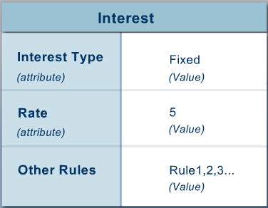
Product Conditions
Product Conditions define default values for Arrangements. Also,
Whether a defaulted value can be modified at the Arrangement level
If modifiable, then, with what restrictions
Each Property must have a Product Condition assigned to it
Notes:
A Product Condition is a set of rules set for a Property Class. It defines the default values for its Attributes. It is also used to define certain other conditions like Negotiation Rules, etc. which we will discuss later. Example: For Interest Property Class, we can define a Product Condition with the Interest Type Attribute set to Fixed, Rate set to 5, and set other rules.

Slide 15
Product Definition - Summary
All share a common set of attributes
TEMENOS Maintained
Property Class
Attributes
Product Line
Property Class
Named types of
User Definable
Product Group
Property
Specific values of
Sub set of
Product
Property
Product
Condition
Notes:
In AA, the Property Classes and Product Lines have been defined by Temenos. The financial institutions can use these “building blocks” to construct the individual Products which can be sold to their customers.
To summarise, the PROPERTY.CLASS definitions are released by Temenos and cannot be amended with the exception of the description fields.
Every Property Class has some features called attributes. Each Property Class can be defined with multiple Product Conditions. They are used to define a set of default values for the Attributes of a Property Class and certain processing rules.
Every Product Line is a composition of multiple Property Classes, some of which can be set as Mandatory by Temenos. Users can create Product Groups under a Product Line by linking Properties to respective Property Classes. Please recollect a Property is nothing but a named instance of a Property Class with all its Attributes and Actions.
Finally a Product is a saleable unit, attached to a Product Group. It is in a Product where the Product Conditions are linked to its Properties.

Slide 16
Relationship between Products and Arrangements
All share a common set of attributes
TEMENOS Maintained
Product Line
Property Class
Property Class
Attributes
Named types of
Bank Definable
Product Group
Property
Specific values of
Sub set of
Product
Property
Product
Condition
Specific instances of
Customer Specific
Arrangement
Arrangement
Conditions
Notes:
Earlier, we have seen the linkage among Product Line, Property Class, Property Class Attributes, Product Group, Property, Product and Product condition.
An arrangement is Customer specific offering of a Product. An Arrangement is in fact a set of conditions called Arrangement Conditions which are inherited from the Product Conditions of respective Product. For example, when a Mortgage Product with LIBOR floating rate and 0.5% standard margin can be offered to a Customer with standard margin reduced to 0.25%. In this case, the Product Condition for the Interest Property has been modified at the Arrangement level and it becomes an Arrangement condition. This modification is possible only if the Negotiation Rules set at the Interest Property Condition allows this.

Slide 17
Product Builder and Catalog - Overview
Product Lines
Accounts
Deposits
Internet Services
Lending
Others
Proxy Services
AA Products
Retail modules AC, AZ, LD and MG
Product Groups
AC$ACCOUNTS
AZ$FIXED.DEPOSIT
LD$LOAN
FOREX
PERSONAL.LOANS
AA Product Builder
Catalog
Other T24 modules
FT, FX, SC, etc
Products
Current Account
Personal Loan
Spot
Non T24 products
Notes:
Product Builder of AA can be used to construct not only AA Products, but also other select retail modules like Accounts, All in one Accounts, Loans and Deposits and Mortgage modules. While AA products can be fully built and serviced by AA, transaction type conditions of the T24 modules mentioned above can be built with AA Product builder. As for other T24 modules and Non T24 products, AA product builder can be used only to enable publishing them into a common Catalog along with AA and select retail modules of T24. AA Product Builder leads into Product Lines, which are predefined by Temenos. Product lines currently available are Accounts (for retail accounts like Savings and Current accounts), Deposits (for retail term deposits), Internet Services (for ARC IB service configuration), Lending (for retail term lending products), others (for any other T24 products and other Bank products for comparison purposes) and Proxy Services. Product Lines can be created only by Temenos and they cannot be created by the User. These “building blocks” can be used to go to the next level of Product Groups, which are pre-defined for select T24 applications. They are user definable for other products. The final stage is defining the Products which are completely user definable. These individual Products are made available for sale to Customers by including them in Catalog.

Slide 18
Product Builder and Catalog – Navigation

Slide 19
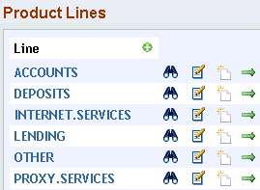
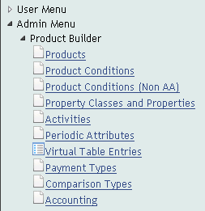
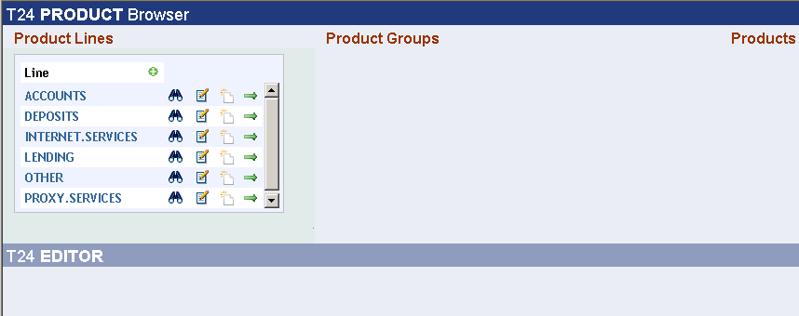
AA Product builder – Navigation tools
Additional Data (e.g. description)
These Product lines are pre configured
Only Temenos can add new product lines
Record viewing & editing area
Record Ids
Notes:
All product lines are pre configured. Few product lines can be used to configure classic T24 modules - ACCOUNTS Product Line for configuring AC module, LENDING Product Line to configure loan products in LD, MG and AZ module.
Full use of LENDING is made available to those who have installed AL (AA Lending).
INTERNET.SERVICES Product Line is meant for configuring ARC Internet banking services configuration. OTHER Product Line can be used to publish other T24 products as well as other banks’ products for comparison.
While only Temenos can add new product lines in AA.PRODUCT.LINE, it is possible for users to change description of these product lines as they desire. This could be achieved by amending the existing description.

Slide 20
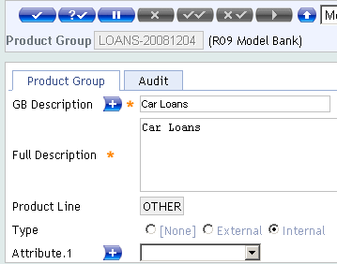
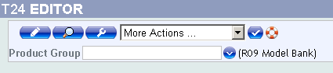
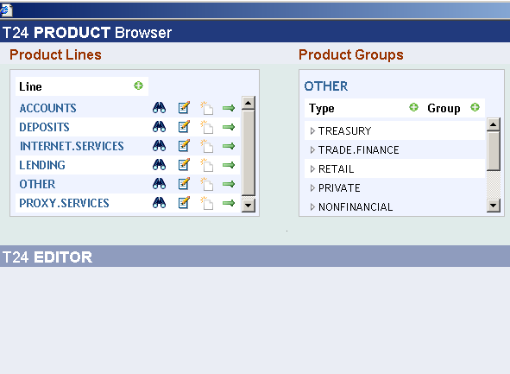
AA Product builder – Navigation tools
New instance
Internal are Bank’s products available for sale
External are other products for comparison. Not for sale
Drill down to instances
Notes:
By using the icon for Drilling down to instances, users can choose a Product line and can drill down to view existing product groups and from there to view the existing Products for the desired group. If the user does not want to amend an existing product, they can choose to create a new product.
By using the icon for New instances, users can create records at the next level. While at Product Line, if this icon is clicked, then it is possible to create new record in Product group in application AA.PRODUCT.GROUP. While at Product group, if this icon is clicked, then it is possible to create new record in AA.PRODUCT.GROUP.
While product lines are pre defined by Temenos, it is possible to define new product groups in AA Loan under LENDING product line. For AC, AZ, LD and MG modules, records in AA.PRODUCT.GROUP are already pre defined. Product groups for any other products can be defined under OTHER product line.
While creating new product groups, Group type can be set as INTERNAL or EXTERNAL. INTERNAL means that the group being defined is the Bank's own product and is available for sale to its customers. At times, it may be necessary for a Bank to do comparison between its own product and one by its competitor to show how its product is superior when compared to products of other Banks.. Hence, products of others can be defined as EXTERNAL, which are not available for sale here.

Slide 21
AA Product builder – Navigation tools
New instance
Internal are Bank’s products available for sale
External are other products for comparison. Not for sale
Drill down to instances
Notes:
By using the icon for Drilling down to instances, users can choose a Product line and can drill down to view existing product groups and from there to view the existing Products for the desired group. If the user does not want to amend an existing product, they can choose to create a new product.
By using the icon for New instances, users can create records at the next level. While at Product Line, if this icon is clicked, then it is possible to create new record in Product group in application AA.PRODUCT.GROUP. While at Product group, if this icon is clicked, then it is possible to create new record in AA.PRODUCT.GROUP.
While product lines are pre defined by Temenos, it is possible to define new product groups in AA Loan under LENDING product line. For AC, AZ, LD and MG modules, records in AA.PRODUCT.GROUP are already pre defined. Product groups for any other products can be defined under OTHER product line.
While creating new product groups, Group type can be set as INTERNAL or EXTERNAL. INTERNAL means that the group being defined is the Bank's own product and is available for sale to its customers. At times, it may be necessary for a Bank to do comparison between its own product and one by its competitor to show how its product is superior when compared to products of other Banks.. Hence, products of others can be defined as EXTERNAL, which are not available for sale here.

Slide 22
Building Reusable Components

Slide 23
AA - Tables used for building components
Tables used for building the re-usable components :
AA.PROPERTY.CLASS
Designed by TEMENOS
AA.PROPERTY
Named copy of Property class
AA.PRD.DES.<PROPERTY.CLASS>
To design product conditions by assigning values to attributes of Property class
AA.PROPERTY and AA.PRD.DES.<PROPERTY.CLASS> set up during implementation
These components could be used across several Products
Composite screens used for building components for ease of operation
Notes:
You have learnt earlier that a Property Class is a fundamental building block of AA and that a Product Line is a combination of Property Classes. Property Classes are released by Temenos and you can only amend their Description.
The components are reusable and can be used across several Products.

Slide 24
AA.PROPERTY.CLASS
Released by TEMENOS to define Actions and Attributes
TYPES multi value Field defines characteristics of Property Class
Product conditions may vary by Currency or not
If CCY is indicated, they vary
Currency specific Product conditions then needed – like Interest
Product conditions may optionally have Currency component
If OPT.CCY is indicated, product conditions may optionally be currency specific
Product conditions may vary by Date
If DATED is indicated, they vary
Dated records needed for Product conditions – like Interest
Multiple properties could be allowed for a Product for same Property class
If MULTIPLE is indicated, allowed – like Regular and Overdue Interest
Option to allow Child Condition not to override the Parent condition
If MERGE is indicated, a Child condition will not override Parent condition
Notes:
Property Classes are building blocks, released by Temenos and you can only amend their Description.
Financial institution uses these functionality of “building blocks” to construct individual products which are available for sale to its customers.
CCY – Product conditions for the same product will vary by currency (e.g. interest and principal conditions). The product property condition definition (AA.PRD.DES.xxxxx) will contain currency in the key. If CCY is not defined then property will NOT be based on currency.
OPT.CCY - Indicates that properties may or may not have Currency component in them. But it needs to have a default non currency condition and when a explicit currency condition is not stated, it picks the default condition for processing. Currently only CHARGE property supports OPT.CCY option.
DATED – Product conditions can vary by date and relevant dated property definition should be used when performing processing. The product property condition will contain an effective date in the record key. If DATED is not specified the record will not contain a date.
MULTIPLE – Allows more than one property of that class to be defined for a single product. If MULTIPLE is not specified only one property of this class can be linked to an AA product.
MERGE – Allows Child condition not to override parent condition blindly.

Slide 25
AA.PROPERTY
Property is a named type / instance of a Property Class
Property is used in Product and not its Property Class
Property is attached to Product Group from where it is derived in a Product
Multiple properties of the same Property Class can be used in a Product, if so allowed in the Property Class
PROPERTY.TYPE multi value Field could be set as Product only, Suspend, Suspend Overdue or left blank
If details for the property are defined only at product level and should not be viewed or edited at Arrangement level, then it should be set as Product only
Accounting rules will not generally be defined at Arrangement level
If a Property is to be allowed to suspend income by not posting to PL, then to be indicated as Suspend
Choice allowed for Properties under Interest and Charge classes
If overdues are also to be suspended, Suspend overdue to be opted in addition to Suspend option
Notes:
Now that we have learnt about a Product Group, we will go into a Product. We sill start with Properties.
In AA we can create named types (instances) of a Property Class which are known as PROPERTIES.
AA.PROPERTY is the T24 application that is used to create properties.
As you have seen earlier, you can attach multiple properties to a Property Class in a Product Group, provided it is allowed in the Property Class.
PROPERTY.TYPE: It can have a null value or one of the following values:
PRODUCT.ONLY: The Property details will be hidden at an Arrangement level, and user cannot view or amend them. For example, Properties under ACCOUNTING Property Class will have this value. It is to prevent the User from viewing or modifying Accounting rules at an Arrangement level. It is enough if the Property is attached to the Product.
SUSPEND: Currently, it is applicable only to Properties under Property Classes: INTEREST and CHARGE. This means that Property would be allowed to be suspended. For example, accrual of Interest can be suspended.
SUSPEND.OVERDUE: Overdues in the Property will be also suspended when the Property is suspended. This goes along with the value SUSPEND i.e. SUSPEND also be one of the values of PROPERTY.TYPE.
More on SUSPEND and SUSPEND.ONLY will be dealt in AA-Loans Course.

Slide 26
Workshop–2 Creation of Customer property
Use Admin Menu > Product Builder > Property Classes and Properties > CUSTOMER
Create a new Property for CUSTOMER Property class
Notes:
Create new property for Customer Property Class

Slide 27
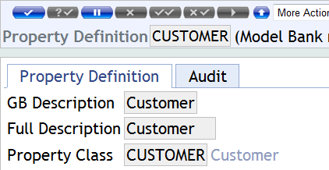
Solution – 2 Creation of Customer property
Notes:
Input property names as desired in record Id for Customer. Give GB description and full description as applicable.
See that the respective property class is automatically defaulted. Commit the record.

Slide 28
Product Conditions
Property classes have defined attributes as designed by TEMENOS
Product conditions define default values for these attributes
And also Negotiation rules
While designing a Product, we indicate corresponding Product condition for each Property
Property Class
Associated Attributes
Product condition
Property
Product
Notes:
We now know how to create a Property. But it is the Product Condition which is practically used in a Product to default values in an Arrangement and to control their modification. We will go into details of the Product Conditions now.

Slide 29
AA.PRD.DES.<PROPERTY.CLASS>
To be defined for every Property class, by associating Id of the respective Property class
AA.PRD.DES.TERM.AMOUNT
Possible to create different Product Conditions for a Property Class
Also possible to create different dated records for Product Condition
Fields of a Product condition represent the attributes of the associated Property Class
AA.PRD.DES.TERM.AMOUNT has Fields like AMOUNT, TERM, REVOLVING etc
AA.PRD.DES.ACCOUNT has Fields like CATEGORY, CURRENCY, CURRENCY.MARKET etc
Notes:
What is the underlying application that is used to store all the information about Product conditions?
Do you still remember?
Product Conditions belong to a Property Class and you can create different Product Conditions for a Property Class
For each Product Condition you can create different dated records
For each Property class a separate application is created with the name AA.PRD.DES.<Property class name>.
You will see an example for this in the next page.

Slide 30
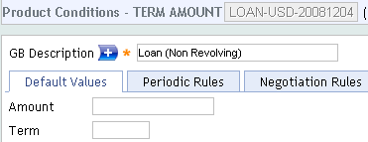
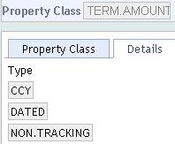
AA.PRD.DES.<Property Class>
Product conditions can be currency specific if the corresponding Property Class allowed it
If Property class has TYPE set to CCY, then its Product conditions would be currency specific
Currency forms a part of Id of records in such Product Conditions
Products that support multiple currencies will require a set of Product conditions for each currency
Default currency set in COMPANY Table will be default currency in Id
Notes:
Product condition can be currency-specific. You may notice that TERM.AMOUNT Product Condition, Currency USD is part of Id.
If Property classes has TYPE set to CCY then Product condition can be currency specific. For such Classes, Products that support multiple currencies will require Product conditions for each currency. Product Conditions that are not currency specific just have one condition, and currency will not be part of ID. For example we have a Product Condition called FIXED.INTEREST-USD. If you support a GBP as well, you need a Product Condition called FIXED.INTEREST-GBP. When assigning conditions to a Property the user simply assigns the condition FIXED.INTEREST . When a new arrangement is created appropriate conditions for currency of arrangement will be used.
TYPE = CCY - Specifies whether Properties created for a Property Class can have Product Conditions based on currency or not. If TYPE field contains a value CCY, then Product Conditions for property will vary by currency. Product condition definition will contain currency in key. If CCY is not defined, property will NOT be based on currency.
TYPE = DATED - Specifies whether Properties created for a Property Class can have date Product Conditions or not. If this field contains a value DATED then Product conditions can vary by date and relevant dated property definition will be used when processing. Product Condition will contain an effective date in record key. If DATED is not specified record will not contain a date.

Slide 31
AA.PRD.DES.<Property Class> - Currency
Assumptions:
TRG Product contains a property that is of TERM.AMOUNT type
TRG Product supports USD and GBP
Question : How many Product conditions need to be created for a property which is an instance of TERM.AMOUNT Property class?
Answer: We will have to create two Product conditions
One for USD and another for GBP
Notes:
The currency forms a part of the ID of Product Conditions that are currency specific.
Assumption: TRG Product contains the a property that is of TERM.AMOUNT type. The TRG Product supports USD and GBP.
Question: How many Product conditions needs to be created for the property which is an instance of TERM.AMOUNT Property class?
Answer: We will have to create two Product conditions. One for USD and another for GBP.

Slide 32
AA.PRD.DES.<Property Class> - Effective Date
Effective Date is the date on which Product Condition values take effect for a Product
If associated Property class has TYPE set to DATED then its Product conditions will be Date specific
All Property Classes have a Type set to DATED so that Product conditions could have an effective date
Effective Date will form part of Id of Product condition
System date is defaulted
Possible to set conditions even with future effective date
Notes:
Each Product Condition record in T24 has an Effective Date. The effective date represents the date on which that particular set of values takes effect for a Product and for any Arrangements which “track” Changes to Product Conditions are typically controlled by effective dating. Note that any Product Condition can be set for Tracking at a Product level.
This allows you to set up any changes to Product Conditions in advance, and when Product using the conditions has been re-published, they will automatically switch over to the new condition on the effective date.
When you do not specify a date in the Id of a Product Condition, date part of the Id defaults to the today’s system date.

Slide 33
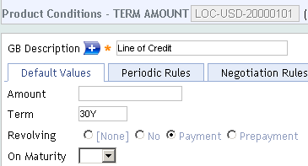

AA.PRD.DES.<Property Class> - Effective Date
Effective date1st Jan 2000
Effective date 8th Feb 2008
Initial condition
Modified Condition
2000
2001
2002
2003
2004
2005
2006
2007
2008
2009
…
Notes:
After you create a record for a Product Condition with a new effective date, it is essential to proof and publish all the Products to which the Condition has been attached. Then the new condition values will be used in Arrangements created on or after the effective date. You will learn more about proofing and publishing later in this course.

Slide 34
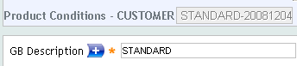
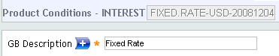
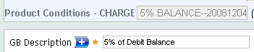
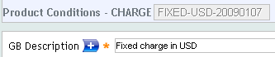
AA.PRD.DES.<Property Class> - Id - Summary
Dated Condition
Currency and Dated Condition
Optional Currency and Dated Condition
Notes:
To summarise, the currency and effective date of a Condition are part of ID of a product condition. The currency defaults to the local currency and the effective date defaults to System date. So to create a USD condition with a future effective date, enter the ID as the name of the condition, then a hyphen, then the currency, then a hyphen, then the date.
Example, FIXED.RATE-USD-20080315.
IF type of a property class is CCY, then its product conditions should be currency specific. CCY will be part of Id.
IF type of a property class is DATED, then its product conditions should be Date specific. Date will be part of Id. The date represents effective date of the product condition.
IF type of a property class is OPT.CCY, then its product conditions may be currency specific. CCY may or may not be part of Id. IF no currency is specified, then two - - will be defaulted after Product condition identifier. Currently CHARGE Property class is OPT.CCY type.

Slide 35
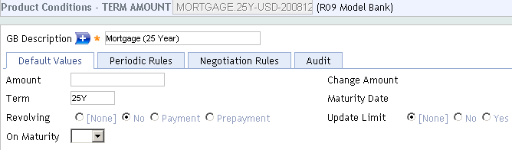
Product Conditions – Example
When these conditions are attached to a Product, then any Arrangement under this Product would get default values of:
25 Y for Term
No for Revolving
No for Update of Limit
Notes:
You can see here a model Product Condition set for the TERM.AMOUNT Property Class.
Default Values
You can see there are different fields like Amount, Term, etc. which are the attributes of the TERM.AMOUNT Property Class. Here, we have defined a value of “25Y” for Term and “No” for Revolving. When this Product Condition is attached to a Property (of the TERM.AMOUNT class) in a Product, these values will be defaulted in an Arrangement created for the Product.
Negotiation Rules
We will learn about this tab in the later part of this course.

Slide 36
Negotiation rules
Specify if and how each attribute value of a product condition may be modified in an arrangement
Examples
The usual term is 5 years while it can be negotiated from 3 to 10 years for Premium Personal Loan
The Commitment Amount may be in the range of USD 200000 to USD 750000 for Personal Loans
Customer can be permitted to choose revolving type of assistance
Notes:
Negotiation Rules are used to specify which attributes may be amended at the Arrangement level, and which must remain the same across all Arrangements. For each attribute that is modifiable, the negotiation rule defines the rules by which they may be modified.
For example, a product may be specified as having a base term of 5 years. At the arrangement level, the bank may wish that the user have the ability to negotiate from 3 to 10 years, A user would define a negotiation rule on the TERM.AMOUNT property condition for the TERM attribute with a “MINPERIOD” of 3Y and a “MAXPERIOD” of 10Y.
Another typical example would be the amount of a loan. Most loan products do not have a default value but rather have a minimum and maximum amount. This is accomplished by the definition of two negotiation rules on the Term Amount property for the AMOUNT attribute.

Slide 37
Negotiation rule
Commitment amount may be negotiated within a band of 25,000 and 500,000 for Personal Loans
Could allow less than 25,000 with Override but should not allow maximum to exceed 500,000
Negotiation Rule Field | Part of Rule
Attribute | “AMOUNT”
Option | “NEGOTIABLE”
Type = MAXIMUM | 500,000
Message | ERROR
Type = MINIMUM | 25,000
Message | OVERRIDE
Notes:
This is an example of negotiation rule for a product condition. We will see more of this, in detail, in the coming slides.

Slide 38
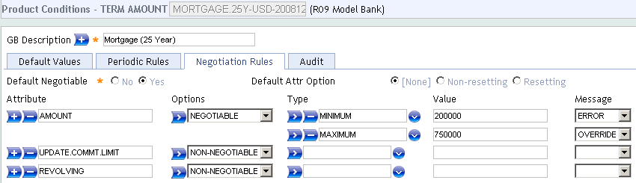
Negotiation rules – Default Negotiable
DEFAULT.NEGOTIABLE
Options: Yes and No. Mandatory field
Defines whether all attributes (Fields) of the Property Class can be Negotiated or not – at top level
Attribute level negotiation rules will always override this setting
UPDATE.COMMT.LIMIT and REVOLVING Fields set as Non-negotiable
Notes:
Now, we will go into the fields of Negotiation Rules tab and find out what they stand for.
Field: DEFAULT.NEGOTIABLE, It is a Mandatory field.
It has 2 Options: Yes and No.
It defines whether all attributes (fields) of the Property Class can be negotiable or not - at a top level.
This top level rule can be over ruled for specific attributes by setting the fields below. In this instance, UPDATE.COMMT.LIMIT and REVOLVING Fields set as Non-negotiable will override the Default Negotiable setting of Yes at top level.

Slide 39
Negotiation rules - Attribute
NR.ATTRIBUTE
Specifies the attribute of Property Class, for which Negotiation rule is defined in associated Fields NR.NEGOTIABLE through to NR.MESSAGE
Must be a valid attribute of Property Class
These attributes will be Fields of Arrangement
Notes:
Let us learn about the multi-valued NR.ATTRIBUTE field.
This specifies the attributes of a Property Class, for which negotiation rule are to be defined in the associated fields NR.NEGOTIABLE through to NR.MESSAGE.
These attributes will become the fields in the Arrangement.
Must be a valid attribute of the Property Class. In this example, where the Product Condition is set for the TERM.AMOUNT Property Class, it should be a valid attribute name of the TERM.AMOUNT Property Class.

Slide 40
Negotiation rules - Options
NR.OPTIONS
Negotiable
Non-Negotiable
Override
Fix Value
Mandatory
Notes:
We will now look into the Field NR.OPTIONS. It is a sub-valued field i.e. it can have more than one value for each Attribute.
NR.OPTIONS has a list of options with values:
Negotiable
Non-Negotiable
Override
Fix value
Mandatory
We will explain about these values in the next page.

Slide 41
Negotiation rules - Options
NEGOTIABLE: Attribute (i.e. Arrangement Field) can be Negotiated / amended at Arrangement level
NON-NEGOTIABLE : Attribute cannot be amended at Arrangement level
NEGOTIABLE and NON-NEGOTIABLE cannot be defined together
OVERRIDE: A default override message generated when the defaulted value is modified at Arrangement level
Useful feature for Authorizers to know about the modification to defaulted values
Notes:
The value NEGOTIABLE indicates that the associated Attribute (i.e. field) can be negotiated (amended) at the arrangement level.
The value NON-NEGOTIABLE indicates that the associated Attribute cannot be amended at the arrangement level.
Both NEGOTIABLE and NON-NEGOTIABLE cannot be defined together.
The value OVERRIDE specifies if a default override message should be generated whenever the default value is modified at the arrangement level.
This feature will be useful for the Authoriser to know which of the defaulted values have been modified at the Arrangement level.
If OVERRIDE is not specified, no override will be generated.

Slide 42
Negotiation rules - Options
MANDATORY: Attribute is mandatory for this product condition
Can only be specified where the Attribute is not defined as mandatory in the Property Class
Useful to change an optional Attribute into a Mandatory one in an Arrangement
FIX-VALUE: Attribute value is to be fixed at Arrangement level
If FIX-VALUE is not specified, the Attribute value will vary with changes to underlying product condition
Notes:
Some of the Attributes have been set as Mandatory at the Property Class and this setting cannot be changed.
However, you can set an optional attribute as Mandatory, by specifying the value MANDATORY. The value MANDATORY specifies if the Attribute is mandatory for this product condition. Can only be specified where the Attribute is not defined as mandatory in the property class.
This means a value has to be mandatorily input for this attribute at the Arrangement level.
The value FIX-VALUE specifies if the Attribute value is to be fixed at the arrangement level. If FIX-VALUE is not specified, the Attribute value will vary with the changes to the underlying product condition.

Slide 43
Negotiation rules - Type
NR.TYPE
Specifies rule for comparing the value input in an Arrangement against value set here
Allows to define more than one negotiation rule for an attribute
Input must be a valid record defined in EB.COMPARISON.TYPE
Notes:
We will look into NR.TYPE here:
This specifies the rule for comparing the value input in an Arrangement against set values here.
For example, MINIMUM against Amount attribute means the value input in the Arrangement should have this minimum value.
This is sub-valued within an Attribute, and thus it is possible to define more than one negotiation rule for an Attribute.
MAXIMUM indicates the Amount attribute can go up to this maximum value.
The NR.TYPE input must be a valid record ID from EB.COMPARISON.TYPE table.

Slide 44
Negotiation rules – Value and Message
NR.VALUE
Specifies the value that links to the rule in NR.TYPE Field
This value is used to compare against the value input in Arrangement
NR.MESSAGE
Specifies whether to raise an error or override message when the rule is broken at Arrangement level
Notes:
NR.VALUE
This field specifies the value that links to the rule in field NR.TYPE.
This is the value(s) to compare against the value input in the Arrangement.
NR.MESSAGE
Specifies whether to raise an error or override message when the rule is broken at the Arrangement level.

Slide 45
Negotiation rules - Options
DEFAULT.ATTR.OPTION
RESETTING
On Renewal activities, Arrangement conditions will be reset from Product
NON-RESETTING
On Renewal activities, arrangement conditions will be maintained from Arrangement level
Notes:
We will now look into the Field DEFAULT.ATTR.OPTION. It is an optional field.
Allowed Values are RESETTING and NON-RESETTING.
RESETTING denotes that during any Renewal Activities (for eg : CHANGE.PRODUCT, ROLLOVER or RESET) the arrangement conditions will be reset from the Product.
NON-RESETTING denotes that during any Renewal Activities arrangement conditions will be maintained from the Arrangement level.

Slide 46
Negotiation rules
Notes:
Let us see a Negotiation Rule set in a Product Condition to TERM.AMOUNT Property Class, which has attributes for Term, Amount, etc.
You can see that default values for Amount is set to null value, Term to 25Y, Revolving to NO and UPDATE.LIMIT to None. Here, by default all attributes of Term Amount Property Class are negotiable i.e. they can be modified in an Arrangement. Restrictions to this general rule is defined under a set of associated fields starting with ATTRIBUTE. Since Amount does not have a default value, it will be null in an Arrangement. Amount is a mandatory Attribute and User will input the value and commit. When the amount is less than 200000, it will be an error condition. When the amount exceeds 750000, it will raise an override message. Though by default all attributes are negotiable, there is an exception to this rule.
Both the attributes UPDATE.COMMIT.LIMIT (set with a default value of NONE) and REVOLVING (set with a default value of NO) are not negotiable i.e. their defaulted values cannot be modified in an Arrangement.
Please note that we have not set any rule for the Attribute TERM. What will happen to that? By default any attribute is negotiable.
Thus TERM is negotiable. It will be defaulted with the set value of 25Y in an Arrangement. Since no rule has been set for this attribute, User can modify it to any value in an Arrangement.

Slide 47
AA- Technical
Version
Attaching Version to Activity Presentation
Routines to Activity API
Adding Local Reference Fields
Enquiry
Conversion

Slide 48
Version
Tables Involved
Activity Presentation
Activity API

Slide 49
Version
Activity Presentation property class allows users to attach version at
Property Class
Property
Activity

Slide 50
Version – Activity Presentation
Activity Presentation
Allows users to attach versions
Can be attached to Property class, property and Activity
First priority is given to Activity level, then Property Level and least given to Property class level

Slide 51
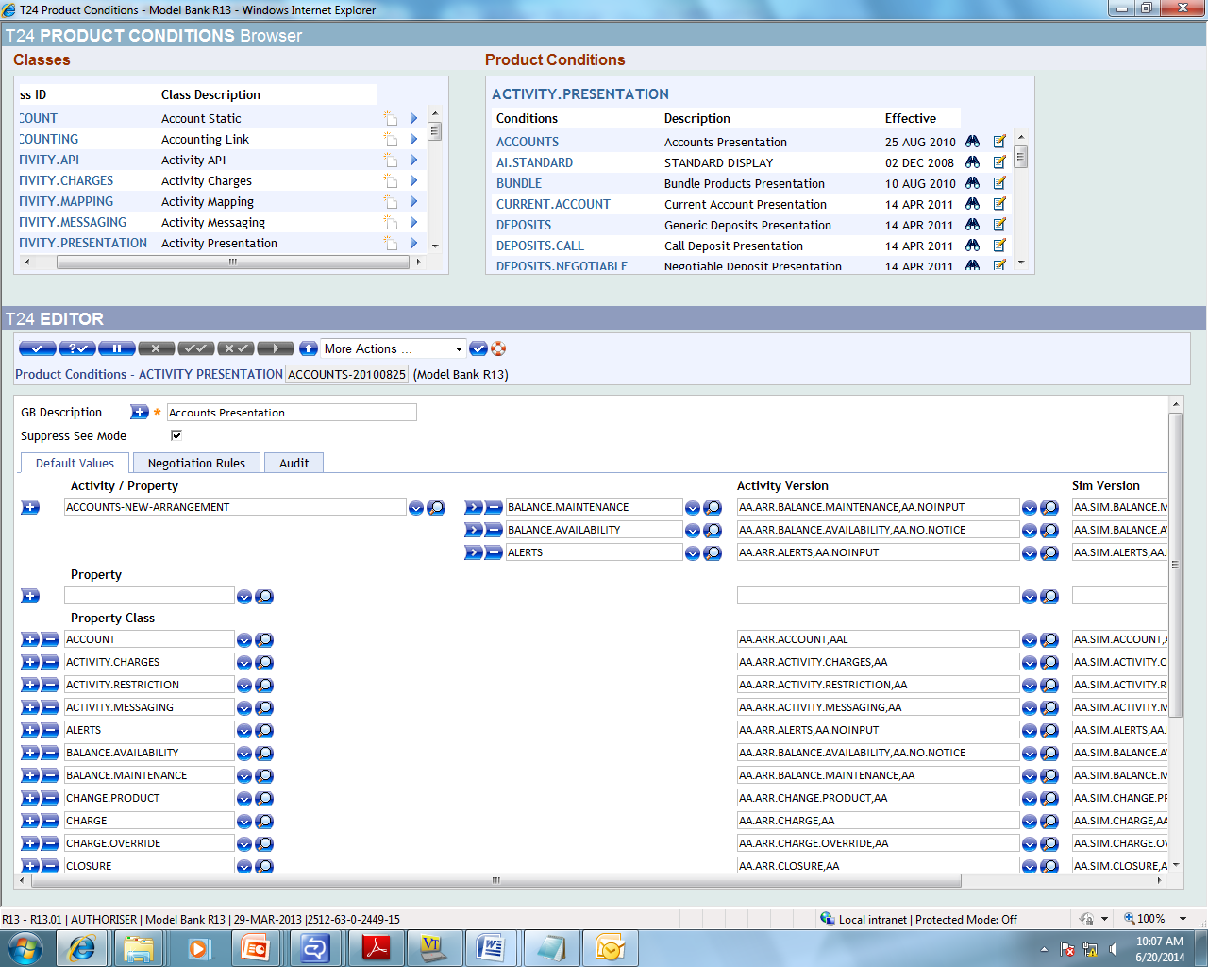
Version – Activity Presentation
Notes:
Activity - ACCOUNT-NEW-ARRANGEMENT – Version is attached to Activity version. Version is triggered at Activity Level.
If version is attached to Activity level that will be triggered first. Then Property level. Finally property class level.
Ex: BALANCE.AVAILABILITY Version is attached that will be triggered first then BALANCE.AVAILABILITY at Property Class level.

Slide 52
Version – Activity API
To Attach Routines to Version – Activity.Api
T24 will not allow to attach routines at version level, the only option is ACTIVITY.API property class
ACTIVITY.API is the property class that allows user defined routines to be linked to activities.

Slide 53
ACTIVITY.API – STEPS INVOLVED
Write a routine Compile and Catalog
Make an entry for user-defined routine in EB.API
Attach the routine to Activity
Pre-routine or Post-routine
Notes:
Routines attached to child followed by parent
Routines attached for an Acitvity
Routines attached to an Activity class

Slide 54
Hierarchy of routine Execution
Pre Validation routine triggered prior to Core Validation
Pre Routine followed by Post routine
Routine attached to Activity

Slide 55
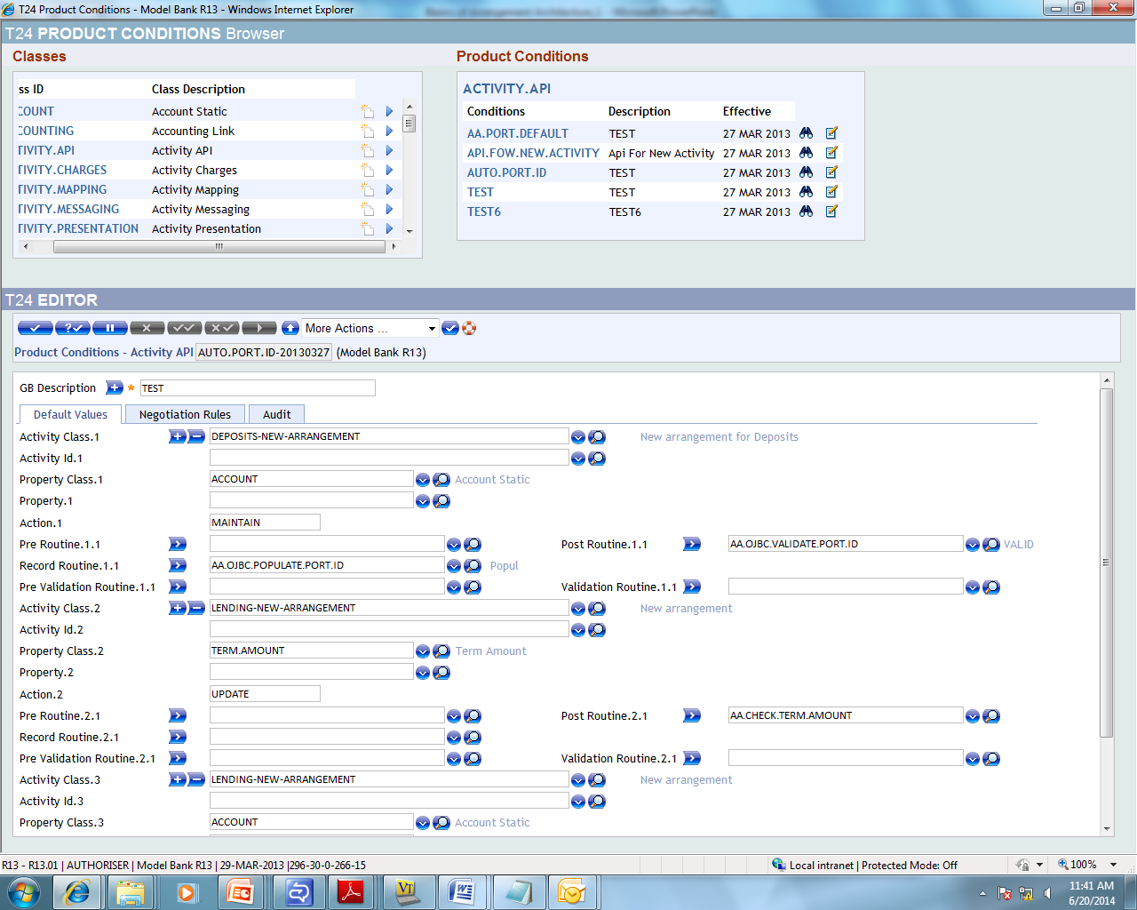
ACTIVITY API – SCENARIO 1

Slide 56
ACTIVITY API
Routine is attached to LENDING-NEW-ARRANGEMENT Activity and the property class is TERM.AMOUNT and the action is update
Notes:
On creation of new lending arrangement term amount field is updated.

Slide 57
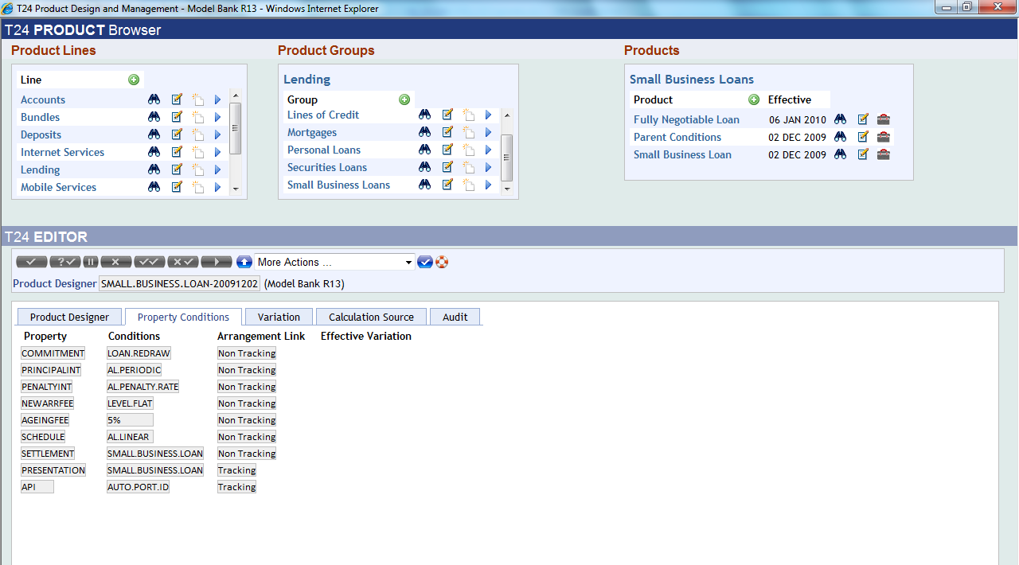
ACTIVITY API
This Activity is then attached to Products. Proofed and Published

Slide 58
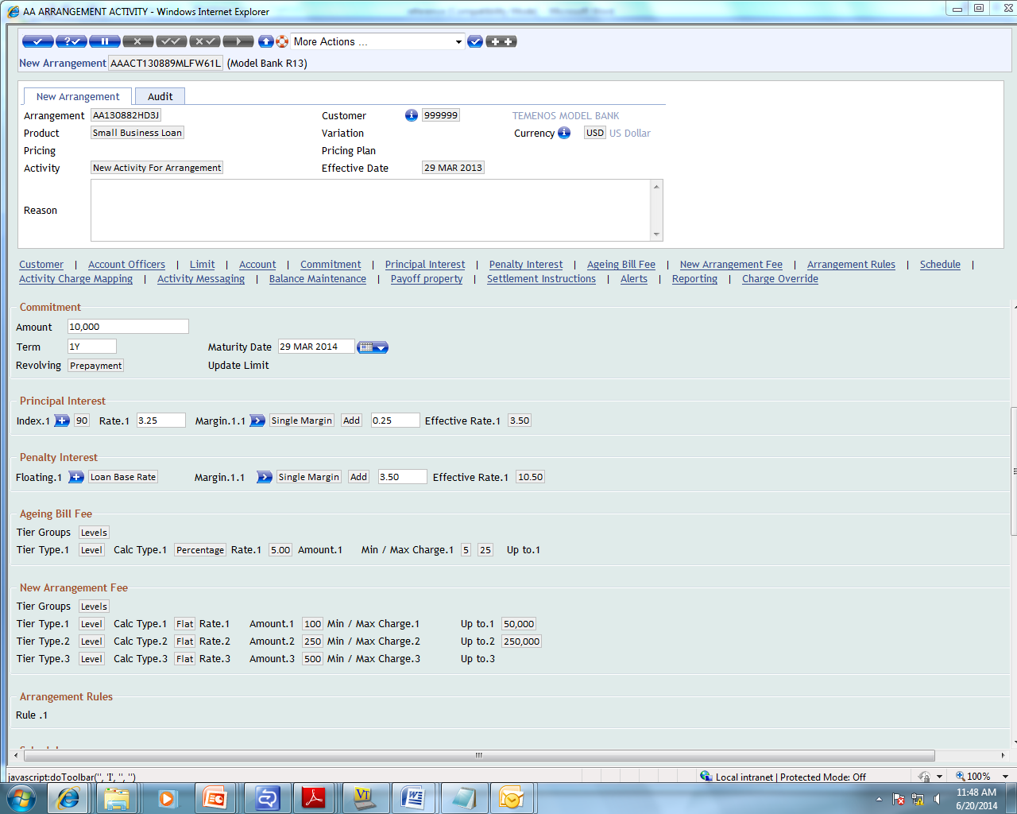
ACTIVITY API
When a new Lending is created the below screen appears

Slide 59
ACTIVITY API
We will retrieve the Term Amount Field and routine attached in the Post routine will be triggered

Slide 60
Routine
SUBROUTINE AA.CHECK.TERM.AMOUNT
$INSERT I_COMMON
$INSERT I_EQAUTE
$INSERT I_AA.LOCAL.COMMON
$INSERT I_AA.TERM.AMOUNT
IF R.NEW(AA.AMT.AMOUNT) LT '10000' THEN
AF = AA.AMT.AMOUNT
ETEXT = ""
CALL STORE.END.ERROR
END
RETURN
END

Slide 61
ACTIVITY API – SCENARIO - 2
Routine will retrieve the Term Amount from LENDING-NEW-ARRANGEMENT and update the Interest field in LENDING-CHANGE-PRINCIPALINT
$INSERT I_COMMON
$INSERT I_EQAUTE
$INSERT I_AA.LOCAL.COMMON
$INSERT I_AA.TERM.AMOUNT
$INSERT I_AA.INTEREST
Y.ARR.ID = c_aalocArrId
ARRANGEMENT.ID = Y.ARR.ID
PROP.CLASS = 'TERM.AMOUNT'
PROP.VAL = ''
returnConditions = ''
RET.ERR = ''
CALL AA.GET.ARRANGEMENT.CONDITIONS(ARRANGEMENT.ID,PROP.CLASS,PROP.VAL,'','',returnConditions,RET.ERR)
R.AA.ARR.TERM.AMOUNT.REC = ''
R.AA.ARR.TERM.AMOUNT.REC = RAISE(returnConditions)
Y.TERM.AMOUNT = R.AA.ARR.TERM.AMOUNT.REC<AA.AMT.AMOUNT>

Slide 62
Local Reference Field
Consider a scenario to store sector information of the customer with the arrangement record. But the customer property class does not have SECTOR field.

Slide 63
LOCAL REFERENCE FIELD
Properties in AA share the same set of fields among different applicaton.
AA.PRD.PROPERTY.CLASS – Holds designer Information
AA.PRD.PRF.PROPERTY.CLASS – Holds Proofing Information, when product is proofed
AA.ARR.PROPERTY.CLASS – Holds Arrangement Information

Slide 64
LOCAL REFERENCE FIELD
Create Local Reference Field – Using LOCAL.TABLE
Attach Local Reference Field to Customer property Class – AA.PRD.DES.CUSTOMER
Check if the Field has been attached to the Customer Property – STANDARD.SELECTION
Notes:
Adding field to AA.PRD.DES.CUSTOMER will replicate to all other application AA.PRD.PRF.PROPERTY.CLASS,AA.PRD.CAT.PROPERTY.CLASS,

Slide 65
LOCAL REFERENCE FIELD - EXAMPLE
When LENDING-DECREASE-COMMITMENT is performed, fields in TERM.AMOUNT and PAYMENT.SCHEDULE property classes alone will be available for input. The task is to set the value of POSTING.RESTRICT that belongs to ACCOUNT property class. Since the requirement is to update a field in a property class that is not available for input, a routine needs to be written to perform this task.

Slide 66
LOCAL REFERENCE FIELDS - SOLUTION
Cannot attach version routines to versions of AA.ARR.XXX applications
ACTIVITY.API to attach user defined routines

Slide 67
LOCAL REFERENCE FIELD - TASK
When an activity LENDING-DECREASE-COMMITMENT is performed, user should be able to input value POSTING.RESTRICT that will automatically affect arrangement account.

Slide 68
LOCAL REFERENCE FIELD - SOLUTION
Create a local reference field POSTING.RESTRICT for TERM.AMOUNT property class
Add local reference field to the version attached to LENDING-DECREASE-COMMITMENT
Create a routine
Make an entry for the routine in EB.API
Attach routine so that it gets triggered when LENDING-DECREASE-COMMITMENT
Proof and Publish

Slide 69
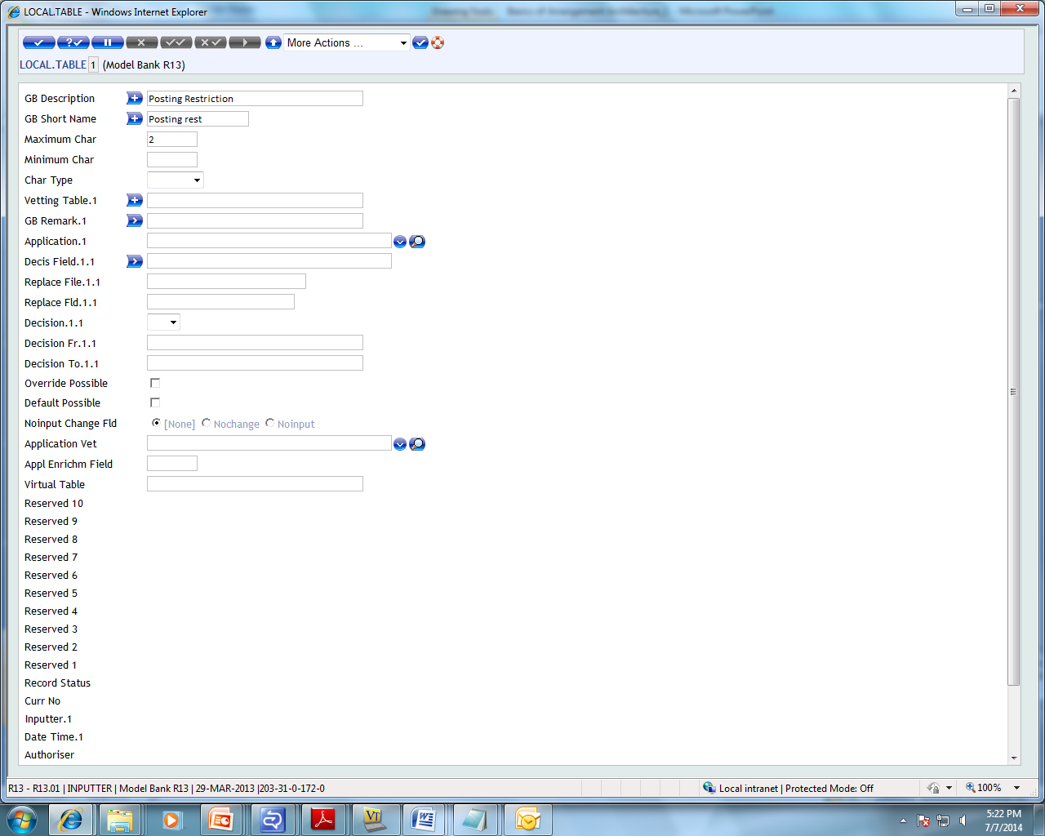
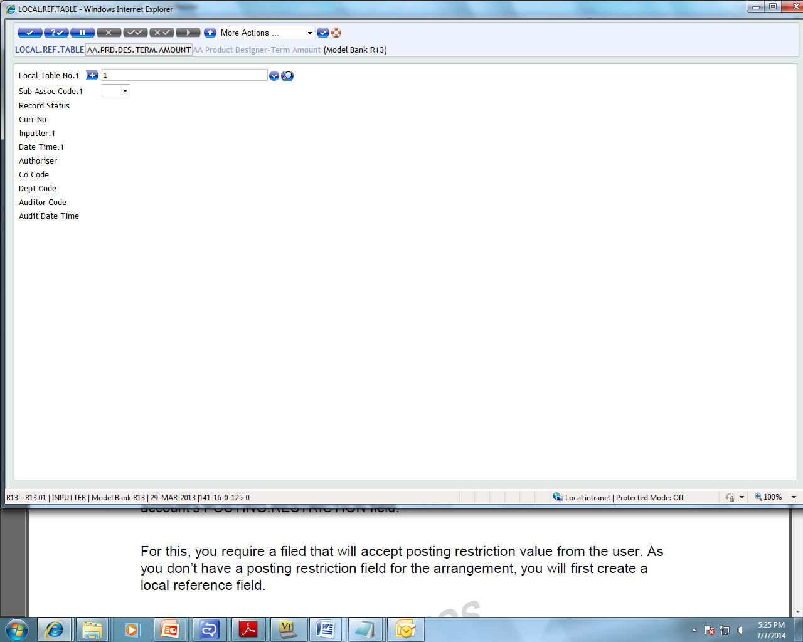
LOCAL REFERENCE FIELD – ACTIVITY API
Create a local reference field called POSTING.RESTRICT for TERM.AMOUNT Property class.

Slide 70
LOCAL REFERENCE FIELD – ACTIVITY API
Add local reference field to LENDING-DECREASE-COMMITMENT. Do this using ACTIVITY.PRESENTATION property class.

Slide 71
LOCAL REFERENCE FIELD – ACTIVITY.API
Write a routine compile and catalog
Make an entry in EB.API
Attach the routine to Activity class or activity
Pre routine or Post routine
Pre validation routine triggered prior to Core Validation
Pre routine followed by Post routines
Routine attached to an Activity

Slide 72
LOCAL REFERENCE FIELD – ACTIVITY API
Create a routine that will pick value from POSTING.RESTRICT field and updates, the arrangement account’s POSTING.RESTRICT field. Routine should trigger after LENDING-UPDATE-ACCOUNT to do this.
Routine will pick value from local reference field and update arrangement account POSTING.RESTRICTION field. To update the arrangement account, this routine should trigger an activity called LENDING-UPDATE-ACCOUNT.
Notes:
LENDING-DECREASE-COMMITMENT is primary activity and LENDING-UPDATE-ACCOUNT is secondary activity.

Slide 73
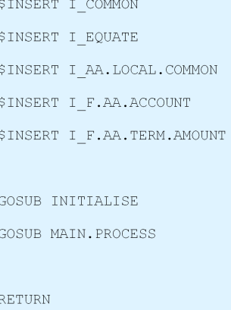
LOCAL REFERENCE FIELD – AA ROUTINE
Notes:
A routine called AA.ACCOUNT.CLOSURE.POST is written. First the required insert files need to be added. I_COMMON and I_EQUATE files holds the common variables and equates for the variables. You must already know the purpose of these files by now. Let us look into the other insert files available.
I_AA.LOCAL.COMMON is an insert file for named common variables that can be used in the local routines developed for AA. Few samples for the named variables available in this file are, c_aalocArrangementRec that holds the main arrangement record. c_aalocArrProductId that holds the product id used by the arrangement etc.
I_F.AA.ACCOUNT has the field names equated to field positions for the ACCOUNT property class. I_F.AA.TERM.AMOUNT has the filed names equated to field position for TERM.AMOUNT property class.
The INITIALISE section is used to initialise local variables used in the API. MAIN.PROCESS section does the main process of the API

Slide 74
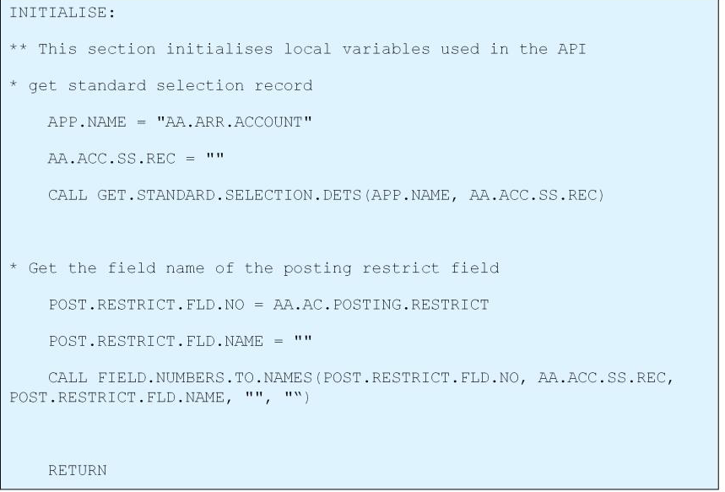
LOCAL REFERENCE FIELD – AA ROUTINE
Notes:
In this part of code, you are retrieving the details from STANDARD.SELECTION for AA.ARR.ACCOUNT application using GET.STANDARD.SELECTION.DETS routine. The field name of posting restriction field is retrieved using FIELD.NUMBERS.TO.NAMES routine.
The FIELD.NUMBERS.TO.NAMES accepts five parameters FIELD.NUMBERS.TO.NAMES(IN.FIELD.NUMBER,R.STANDARD.SELECTION,FIELD.NAME,DATA.TYPE,ERR.MSG)
Incoming Parameters:
IN.FIELD.NUMBER – specifies the field number to be converted
R.STANDARD.SELECTION - specifies the standard selection record
Outgoing Parameters:
FIELD.NO – used to hold the returned field name, blank if not found
DATA.TYPE - data type is set to “D” for now, in case of error, any other data type passed back
ERR.MSG - variable to store error messages
19

Slide 75
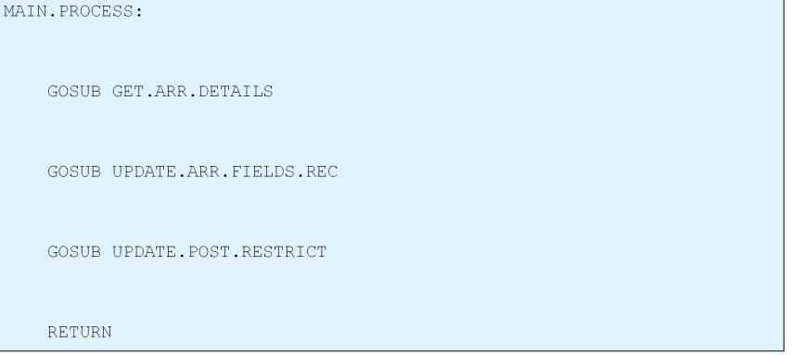
LOCAL REFERENCE FIELD – AA ROUTINE

Slide 76
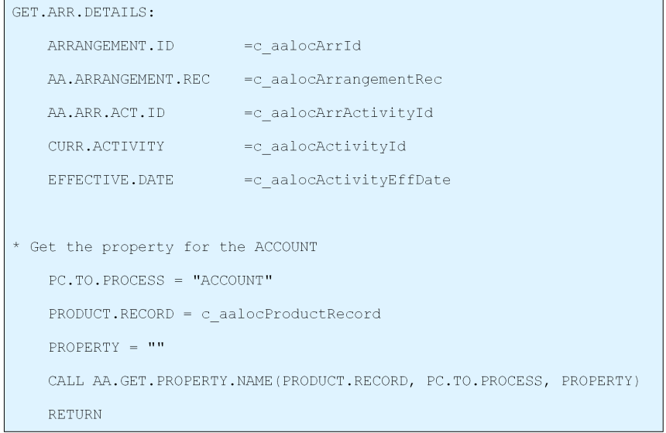
LOCAL REFERENCE FIELD – AA ROUTINE
Notes:
If you see the code, the common variables are used to retrieve the arrangement information. These variables are defined in I_AA.LOCAL.COMMON
c_aalocArrId holds the arrangement id
c_aalocArrangementRec holds the whole arrangement record
c_aalocArrActivityId holds the arrangement activity id
c_aalocActivityId holds the activity id. In this case the activity id is LENDING-DECREASE-COMMITMENT
c_aalocActivityEffDate holds the effective date for the activity
c_aalocProductRecord holds the publishes product record for the arrangement
AA.GET.PROPERTY.NAME routine will retrieve the property name. It takes two inputs, the product record and the property class for which you wish to retrieve the property name
SUBROUTINE AA.GET.PROPERTY.NAME(PRODUCT.RECORD, PROPERTY.CLASS, PROPERTY)
Incoming Parameters:
PRODUCT.RECORD – holds the product definition
PROPERTY.CLASS – holds the property class for which properties are sought
Outgoing Parameters:
PROPERTY - Returns a list of properties (separated by FMs) for the given property

Slide 77
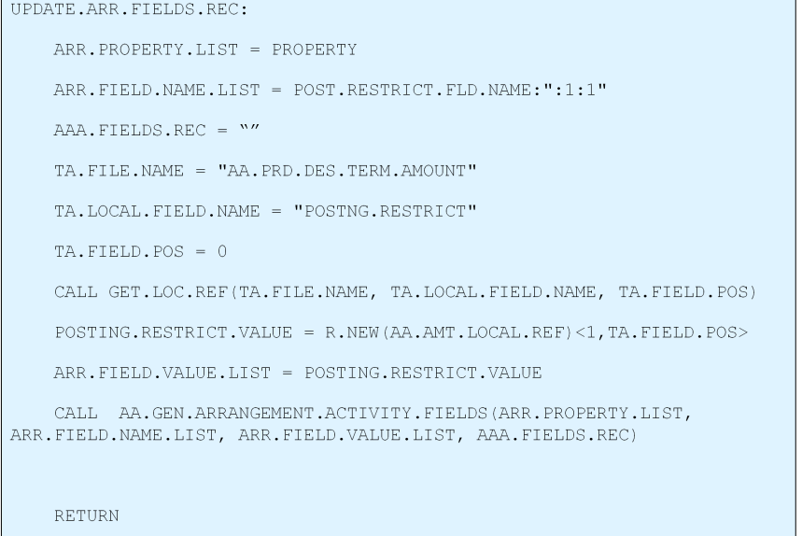
LOCAL REFERENCE FIELD – AA ROUTINE
Notes:
UPDATE.ARR.FIELDS.REC paragraph is used to update the property fields in AA.ARRANGEMENT.ACTIVITY. In order to create a new arrangement record you need to supply values that need to change in AA.ARR.ACCOUNT like
Field Name -> POSTING.RESTRICT
Multi value and sub value position -> 1:1
Value -> that has been retrieved from the local reference field and stored in a variable called POSTING.RESTRICT.VALUE
After getting all the required values to generate an arrangement activity, instead of manually forming an OFS message, you can call AA.GEN.ARRANGEMENT.ACTIVITY.FIELDS routine with the property name, field name and field values.
AA.GEN.ARRANGEMENT.ACTIVITY.FIELDS(ARR.PROPERTY.LIST, ARR.FIELD.NAME.LIST, ARR.FIELD.VALUE.LIST, ARR.ACT.FIELDS.REC)
Input parameters:
ARR.PROPERTY.LIST List of arrangement properties
ARR.FIELD.NAME.LIST List of field names of the given arrangement property
ARR.FIELD.VALUE.LIST Values for the field names of the given arrangement property
Outgoing Parameters:
ARR.ACT.FIELDS.REC Mapped arrangement activity record

Slide 78
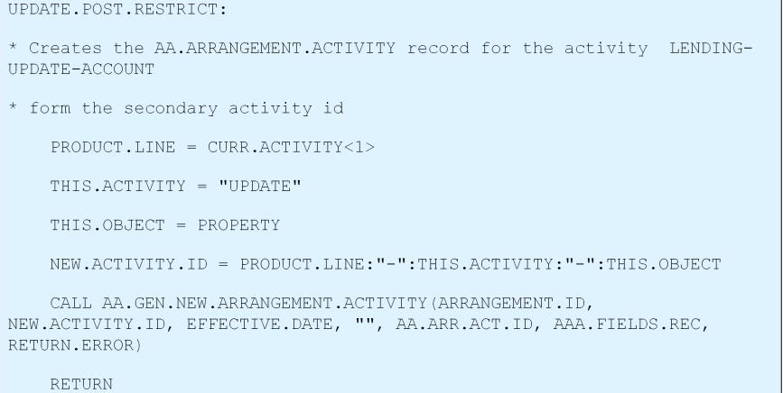
LOCAL REFERENCE FIELD – AA ROUTINE
Notes:
This paragraph UPDATE.POST.RESTRICT is used to create the AA.ARRANGEMENT.ACTIVITY record for the activity LENDING-UPDATE-ACCOUNT. The routine AA.GEN.NEW.ARRANGEMENT.ACTIVITY would create new arrangement activity record and append the same as secondary activity by calling the routine AA.SECONDARY.ACTIVITY.MANAGER
AA.GEN.NEW.ARRANGEMENT.ACTIVITY(ARRANGEMENT.ID, NEW.ACTIVITY, EFFECTIVE.DATE, ARR.TXN.DETAILS, ARR.ACTIVITY.ID, ARR.ACT.FIELDS.REC, RETURN.ERROR)
Incoming Parameters:
ArrangementId – holds the id of the arrangement
NewActivity – holds the secondary activity to be triggered
EffectiveDate - holds the effective date of the activity
ArrTxnDetails - holds transaction information of the arrangement
ArrActivityId – holds the parent arrangement activity id
ArrActFieldsRec – holds the new arrangement activity record
Outgoing Parameters:

Slide 79
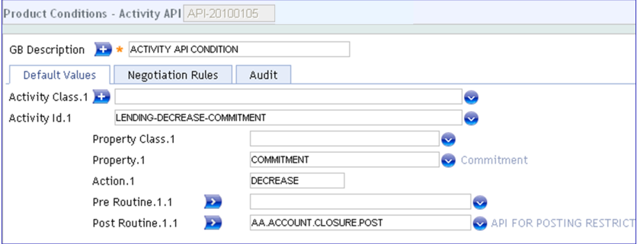
LOCAL REFERENCE FIELD – ACTIVITY API
Create a Product Condition API
Attach the product condition to the activity LENDING-DECREASE-COMMITMENT
Notes:
Create a product condition called API and attach the routine as the post routine. If you notice,
The activity id is LENDING-DECREASE-COMMITMENT
The Property name is COMMITMENT
The action for which the routine has to be triggered is DECREASE
The POST.ROUTINE field has been used to attach the routine AA.ACCOUNT.CLOSURE.POST that you created just now

Slide 80
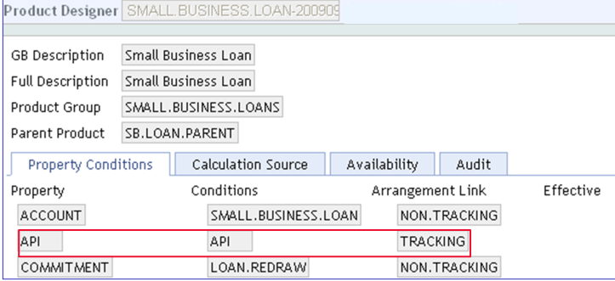
LOCAL REFERENCE FIELD – ACTIVITY API
Attach product condition to the desired product. Proof and Publish

Slide 81
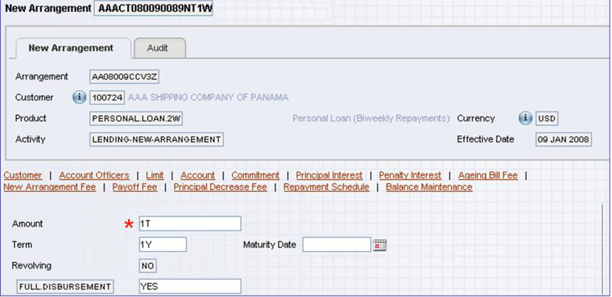
LOCAL REFERENCE FIELD – ACTIVITY API
Create an Arrangement
Notes:
Create a new arrangement. If you see here, the activity is LENDING-NEW-ARRANGEMENT and the local reference field POSTNG.RESTRICT does not appear for Commitment property. Why is this so? It is because, you have attached the field to a version that will appear only during LENDING-DECREASE-COMMITMENT activity

Slide 82
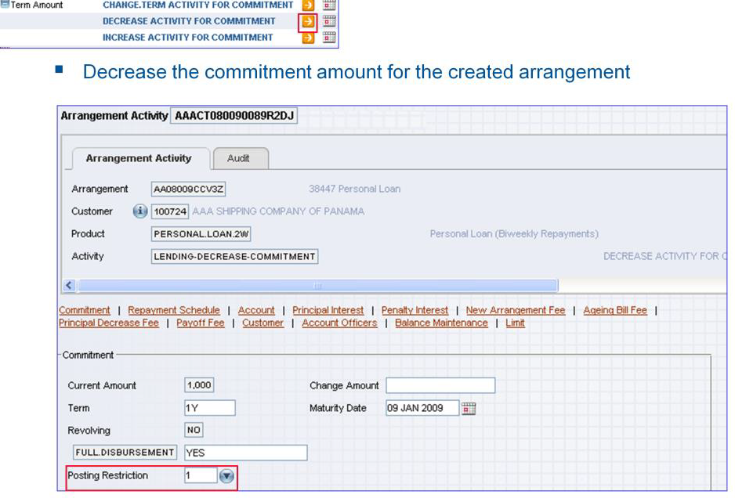
LOCAL REFERENCE FIELD – ACTIVITY.API
Notes:
After creating the arrangement, perform a decrease activity for commitment amount. It opens up a version where the user can specify the posting restriction value. Specify 1 (Post No Debits). Commit the record.

Slide 83
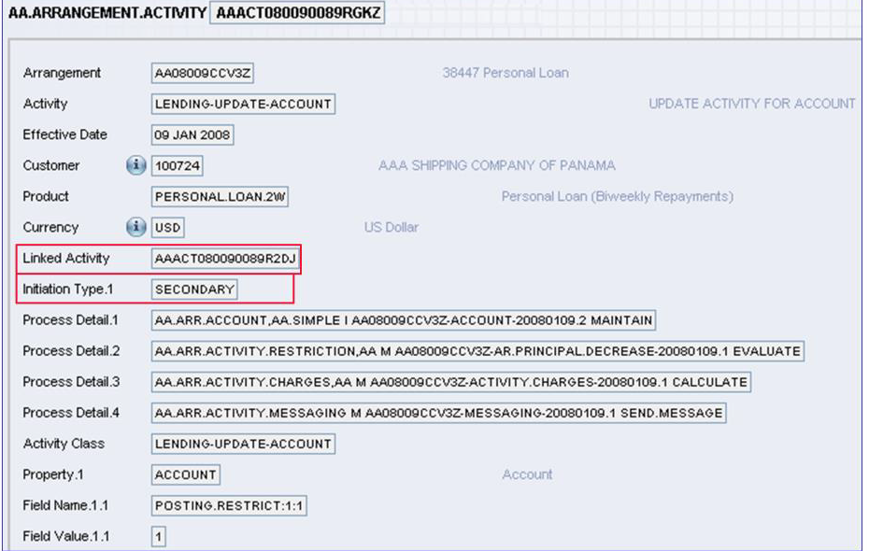
LOCAL REFERENCE FIELD – ACTIVITY API
Notes:
Let us now look into the child activity in AA.ARRANGEMENT.ACTIVITY application. The linked activity is AAACT080090089R2DJ, this is the LENDING-DECREASE-COMMITMENT activity that generated the LENDING-UPDATE-ACCOUNT activity. The Initiation type is SECONDARY. The activity class is LENDING-UPDATE-ACCOUNT, the property on which the action should take place is ACCOUNT. The field that has to be updated is POSTING-RESTRICT at multi value and sub value position 1:1. The value that has to used for updating is 1. If you remember, this is the value that we specified in the POSTNG.RESTRICT local reference field

Slide 84
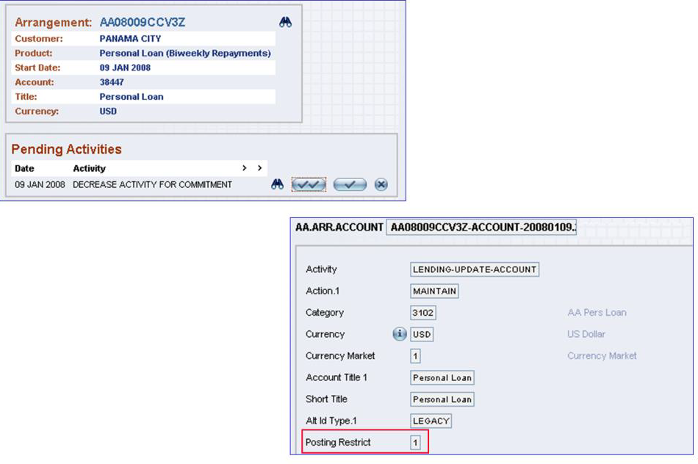
LOCAL REFERENCE FIELD – ACTIVITY API
Notes:
If you open the arrangement, the decrease activity for commitment will be pending. You do not see update activity for account property pending because it is a secondary activity. On authorising the parent activity, the child activity will automatically be authorised.
Check the arrangement’s account to see if the posting restriction is updated

Slide 85
CONVERSION ROUTINE - SCENARIO
The routine will get total term amount balance of an arrangement
The value of arrangement ID is passed through the variable COMI
API, AA.GET.PROPERTY.NAME is used property list for the product record.
CALL AA.GET.PROPERTY.NAME(PRODUCT.RECORD,PROP.CLASS,Y.PROP.LIST)
PRODUCT.RECORD – Contains Product details
Prop.class – Contains the property class for which property list needs to be obtained
Property.list – The list of properties for the particular class
API, AA.GET.PERIOD.BALANCES is used to get Balance amount of account
CALL AA.GET.PERIOD.BALANCES(ACCOUNT.ID, BALANCE.TO.CHECK, REQUEST.TYPE, START.DATE, END.DATE, SYSTEM.DATE, BAL.DETAILS, ERROR.MESSAGE)
Notes:
GET.ARR.DETAILS is used to get details of the arrangement
UPDATE.ARR.FIELDS is used to map the posting restrict field
UPDATE.POST.RESTRICT is used to generate a new activity to update posting restriction

Slide 86
CONVERSION ROUTINE
API,AA.GET.ARRANGEMENT.PRODUCT is used to get the product name for a given arrangement.
CALL AA.GET.ARRANGEMENT.PRODUCT(Y.ARR.ID,Y.EFF.DATE,'',Y.PRODUCT,Y.PROPERTY)
Y.ARR.ID (input)<mandatory> = The arrangement id. This explains the arrangement for which the product is required.
y.eff.date = Y.PRODUCT (output parameter) = the product for which the arrangement is created.
Y.PROPERTY (output parameter) = The list of properties for that product are returned.
Notes:
Steps involved in achieving :
The core API AA.GET.ARRANGEMENT.PRODUCT is called with the Arrangement Id as input .The routine return the Product and the properties of the corresponding Arrangement.
The product name that is achieved in the above step is used to read the product table and the record is obtained for the corresponding product.
This table contains the product group that the product belongs and the properties of the product.
The arrangement id is used to read the ARRANGEMENT table which returns the product group for the particular arrangement.
The product group is used to read the table AA.PRODUCT.GROUP, the record is stored.
The core API AA.GET.PROPERTY.NAME is used with input as the record obtained in the previous step. The routine returns the property list as output.
The property list is append with "TOT"
The application for Account is obtained and the corresponding id is obtained from the arrangement record.
The API " AA.GET.PERIOD.BALANCES" is called to obtain the balance of the corresponding account id is obtained. The bal.details contains the balance outstanding amount which is stored.
OUTPUT: The output is the account balance which is obtained through the AA.GET.PERIOD.BALANCES

Slide 87
Thank you

